Slide 1
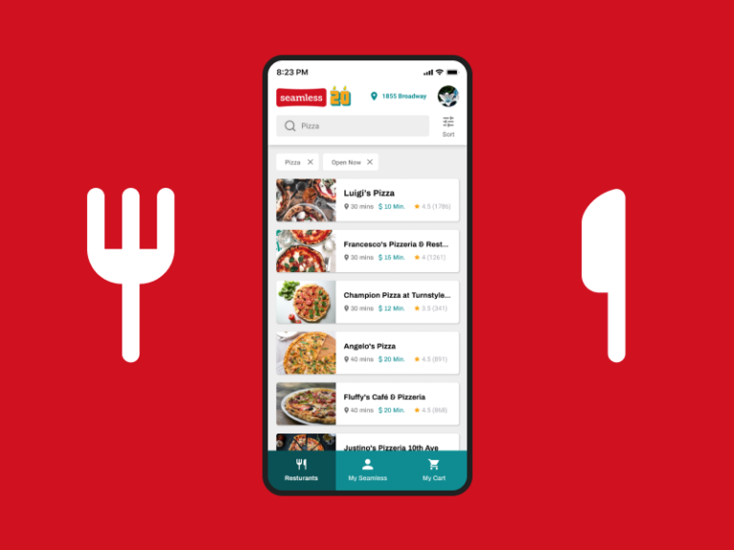
FoodHub Data Analysis
Project 1: Python Foundations
24 June 2022
by Hung Lin Lin, Faith
This Photo by Unknown Author is licensed under CC BY-SA-NC

Slide 2
Contents / Agenda
Executive Summary
Business Problem Overview and Solution Approach
Data Overview
EDA - Univariate Analysis
EDA - Multivariate Analysis
Appendix

Slide 3
Conclusions from Analysis
Executive Summary
The restaurants fulfilling criteria to get promotional offer are Shake Shack, The Meatball Shop, Blue Ribbon Sushi and Blue Ribbon Fried Chicken. Together with Parm, they are also among top 5 restaurants by orders received and revenue generated.
There are 1898 orders but only 1200 customer ID, indicating that there are repeated orders by same customer(s), which is confirmed by further checking with the value counts of each customer ID. Therefore, the app can be deemed useful by customer(s).
The ID of top 3 most frequent customers to receive 20% discount vouchers given by the company, are 52832, 47440 & 83287, with 13, 10 & 9 as their respective number of orders placed.

Slide 4
Net Revenue Generated by the Company Across All Orders is around 6166.3 dollars.
The revenue generated by the restaurants ranges from 506.47 to 3579.53 dollars. Shake Shack is leading well ahead. It’s revenue generated is more than 2/3 of the restaurant in 2nd position.
There is slower delivery time on weekdays, as compared to weekends, with a difference of mean by 6mins, despite lesser orders on weekdays.
Percentage of orders that take more than 60 Minutes to get delivered from time order is placed is 10.54%. The maximum time exceeded is by 8 mins.
The demand in orders is much higher on weekends, as compared to weekdays.

Slide 5
American is the most popular cuisine on weekends. Japanese, Italian and Chinese cuisine show a lot of potential. On the contrary, Korean, Thai, Southern, French, Spanish and Vietnamese are very low in demand.
Rating is important as it is positively correlated to cost of the order, which has direct effect on revenue generated by the company.
‘Not given’ accounts for 736 out of 1898 values (around 38.78%) for rating column. It is quite a substantial amount. The inability to include these data together with numerical rating in analysis, can have a significant effect on the conclusions that can be drawn from the dataset. There are also no categories for low rating such as 1 or 2.
There is much larger number of rating for 5 and also 4, as compared to 3, indicating favourable customer experience.

Slide 6
Recommendations to Help Improve Business (Cuisine Type and Feedback Ratings)
Efficient food preparation and smooth delivery need to be ensured especially for American cuisine on weekend, and also orders for restaurants, Shake Shack, The Meatball Shop, Blue Ribbon Sushi, Blue Ribbon Fried Chicken and Parm.
Reduce delivery time for weekday to match up with weekend, to boost weekday orders. Reasons for the slower delivery time need to be further investigated, to pinpoint areas for improvement and bridge any gaps.
Need to procure and analyse more data on rating listed as ‘Not given’ to better understand and manage customer experience, to boost future rating and revenue. Especially when there are no categories for low rating such as 1 or 2, it would be beneficial to analyse the nature of the notes written, whether they are positive eg compliments, negatives eg complaints or just general feedback.

Slide 7
Explore ways to boost number of numerical ratings, such as inclusion of reward system for numerical rating given eg offering virtual coins, cashback rebate, discount e vouchers, redemption of complimentary side dish/beverage, chance to enter lucky draw, for more precise and realistic picture to be drawn.
Widen coverage of rewards for frequent customers to further encourage repeat purchases, eg by inclusion of loyalty rewards like Cashback rebate.
Promotion of the app to reach wider audience, to increase orders and revenue generated.
Look into the reasons for frequent customers’ repeated purchase to better understand the strength of the app.
There can be further analysis of whether the higher cost of the order is due to price of food, or greater quantity ordered.

Slide 8



Business Problem Overview and Solution Approach
Context
The number of restaurants in New York is increasing day by day.
Lots of students and busy professionals rely on those restaurants due to their hectic lifestyles.
Online food delivery service is a great option for them.
It provides them with good food from their favorite restaurants.
Business
Foodhub
(food aggregator company)
Offers access to multiple restaurants through a single smartphone app
Earns money by collecting a fixed margin of the delivery order from the restaurants

Slide 9
Function of App
Customer orders online through app
Restaurant receives and confirms order
Company assigns delivery person to pick up order
Delivery Person uses map to reach restaurant and waits for food package
Restaurant hands over food package to delivery person
Customer orders online through app
Customer can rate order in app
Delivery Person confirms drop-off in app
Delivery Person delivers food package to customer
Delivery Person travels to customer's location
Delivery Person confirms pick-up in app
Notes:
Customer orders online through app
restaurant receives and confirms order
company assigns delivery person to pick up order
delivery person uses map to reach restaurant and waits for food package
Restaurant hands over food package to delivery person
delivery person confirms pick-up in app
delivery person travels to the customer's location
delivery person delivers food package to customer
delivery person confirms drop-off in app
customer can rate order in app

Slide 10

Objective
Get fair idea about demand of different restaurants which will help in enhancing customer experience.
Find answers to key questions shared by Data Science team to help company improve business.
Solution Approach
Gain Data Overview
Perform Exploratory Data Analysis, which encompasses Univariate Analysis & Multivariate Analysis, on the data stored by FoodHub, of different orders made by registered customers in their online portal.
Extract relevant Conclusion, Actionable Insights and Recommendations, majorly focusing on cuisine type, feedback ratings and delivery time.

Slide 11
Data Information
The data contains the different data related to a food order. The detailed data dictionary is given below.
order_id : Unique ID of the order
customer_id : ID of the customer who ordered the food
restaurant_name : Name of the restaurant
cuisine_type : Cuisine ordered by the customer
cost_of_the_order : Cost of the order
day_of_the_week : Indicates whether the order is placed on a weekday or weekend
(The weekday is from Monday to Friday and the weekend is Saturday and Sunday)
rating : Rating given by the customer out of 5
food_preparation_time: Time (in minutes) taken by the restaurant to prepare the food. This is calculated by taking the difference between the timestamps of the restaurant's order confirmation and the delivery person's pick-up confirmation.
delivery_time : Time (in minutes) taken by the delivery person to deliver the food package. This is calculated by taking the difference between the timestamps of the delivery person's pick-up confirmation and drop-off information.
Observations | Variables
1898 | 9
Note:
Values in rating column listed as ‘Not Given’, said to be due to users choosing note to rate the restaurants.

Slide 12
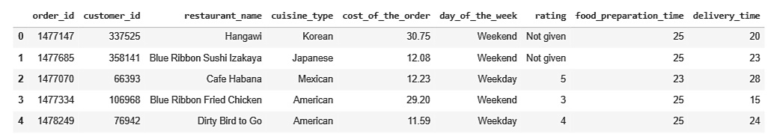
Data Overview
Sample of Dataset (First few rows)
There are 1898 rows and 9 columns.
The restaurant_name, cuisine_type, day_of_the_week and rating columns are of object type, while the rest of the columns are numerical in nature. The object type columns contain categories in them.
There are no missing values. All the columns have 1898 observations and there are no null values for each column.
Once an order is placed, time taken to prepare food: Minimum - 20mins, Average - 27.37mins, Maximum - 35mins
736 orders are not rated, as their ratings are ‘Not given’.
Sample of Dataset (First few rows)
There are 1898 rows and 9 columns.
The restaurant_name, cuisine_type, day_of_the_week and rating columns are of object type, while the rest of the columns are numerical in nature. The object type columns contain categories in them.
There are no missing values. All the columns have 1898 observations and there are no null values for each column.
Once an order is placed, time taken to prepare food:
Minimum - 20mins, Average - 27.37mins, Maximum - 35mins
736 orders are not rated, as their ratings are ‘Not given’.

Slide 13
EDA - Univariate Analysis
Explore all the variables and provide observations on their distributions.
Order ID
There are 1898 order ID.
Customer ID
There are 1200 customer ID. The ID of top 3 most frequent customers are 52832, 47440 & 83287 and their respective number of orders placed are 13, 10 & 9. They will receive the 20% discount vouchers given by the company.
Restaurant Name
There are 178 restaurant names. The top 5 restaurants in terms of number of orders received are Shake Shack, The Meatball Shop, Blue Ribbon Sushi, Blue Ribbon Fried Chicken and Parm.

Slide 14
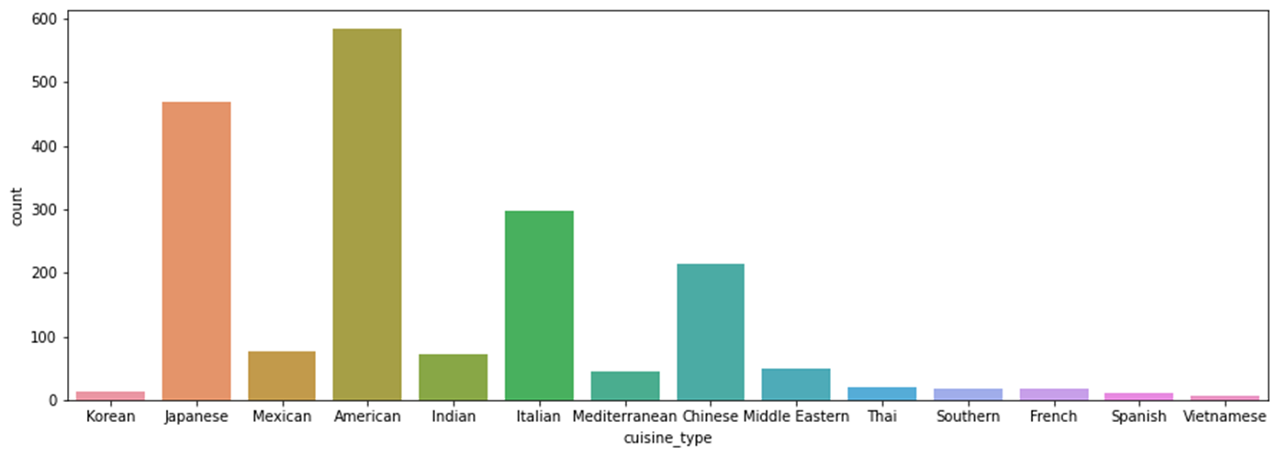
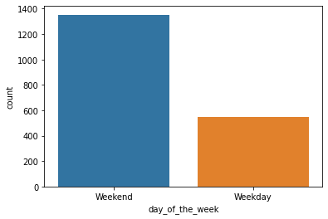
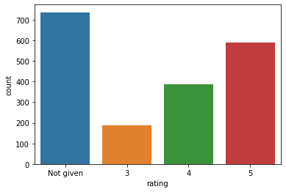
Cuisine Type
Day of the Week
Rating
There are 14 cuisine types, Korean, Japanese, Mexican, American, Indian, Italian, Mediterranean, Chinese, Middle Eastern, Thai, Southern, French, Spanish and Vietnamese.
Only 4 have much more orders than the rest. They are in order of demand, American, Japanese, Italian and Chinese.
Korean, Thai, Southern, French, Spanish and Vietnamese are very low in demand.
The most popular cuisine on weekends is American.
There are 2 categories, weekend and weekday.
The orders for weekend is more than double the orders for weekday.
There are 4 categories of rating given.
The number of rating for 5 is about same amount for rating 3 and 4, and the number of rating for 4 is about double the number of rating for 3, indicating favourable customer experience.

Slide 15
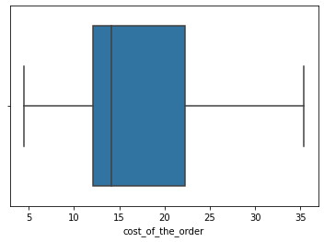
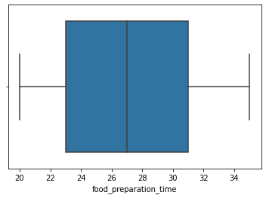
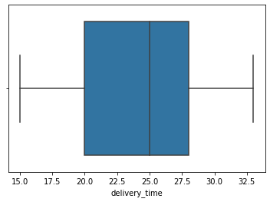
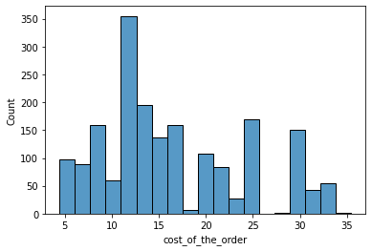
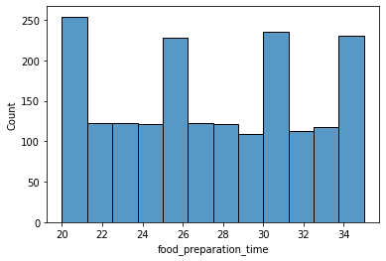
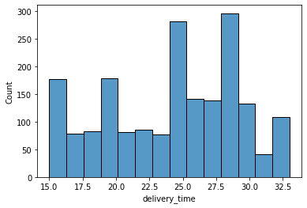
Cost of the Order
Food Preparation Time
Delivery Time
The distribution is right skewed, ranges between 4.47 – 35.41 dollars.
The highest number of order is between 10 - 15 dollars.
The number of total orders that cost above 20 dollars is 555 out of 1898 orders. Percentage of orders above 20 dollars is 29.24%.
The distribution is relatively normal, ranges from 20 -35 mins.
The mean preparation time is 27.37mins.
The distribution is slightly left skewed, ranges from 15 – 33mins.
The mean delivery time is 24.16 mins.

Slide 16
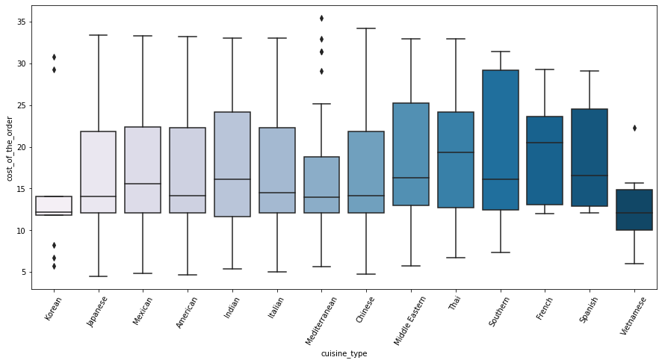
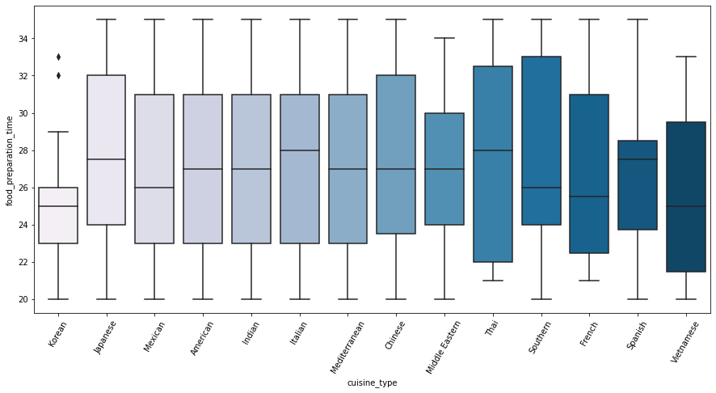
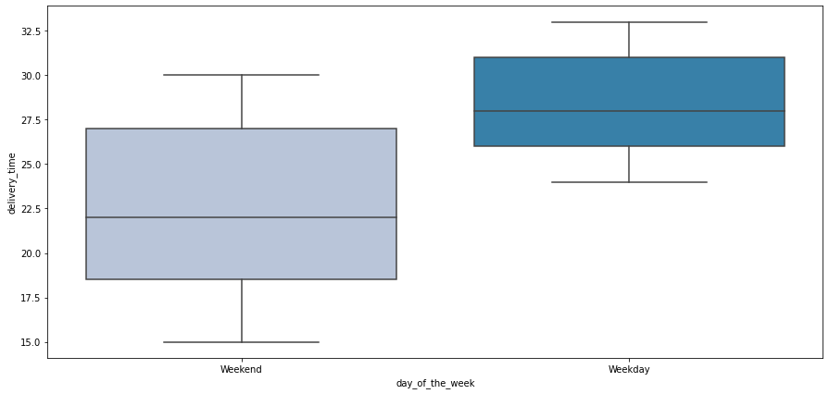
Cuisine vs Cost of the Order
EDA - Multivariate Analysis
Explore relationships between important variables.
Cuisine vs
Food Preparation Time
Day of the Week vs
Delivery Time
Thai and French have much higher median for cost of the order, while Korean and Vietnamese have much lower median for cost of the order.
The cost of the order is generally low for Korean, Vietnamese and Mediterranean, with Korean and Mediterranean having some outliers.
French and Spanish have much higher minimum cost of the order.
Korean, Southern, French and Vietnamese have lower median for food preparation time.
Middle Eastern and Vietnamese have lower maximum food preparation time, while Korean has very low maximum food preparation time, though having some outliers.
Thai and French have slightly higher minimum food preparation time.
The mean delivery time on weekdays is around 28 mins.
The mean delivery time on weekends is around 22 mins.
Weekend has lower delivery time as compared to weekday, with difference of 6 mins.

Slide 17
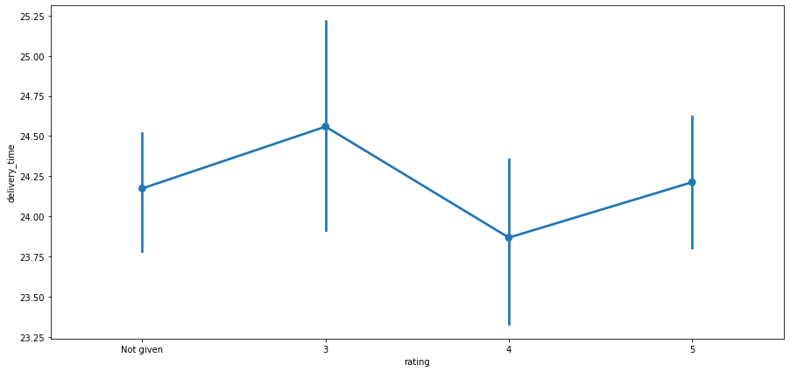
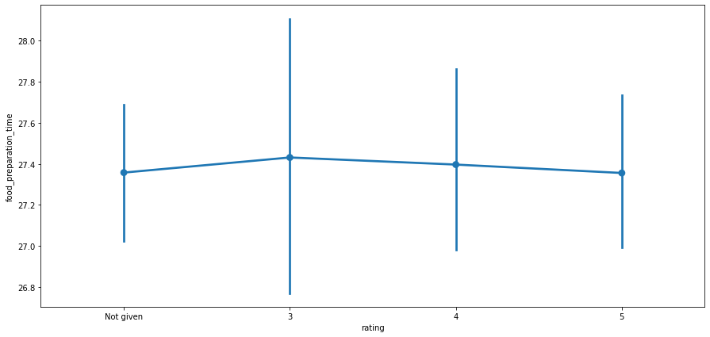
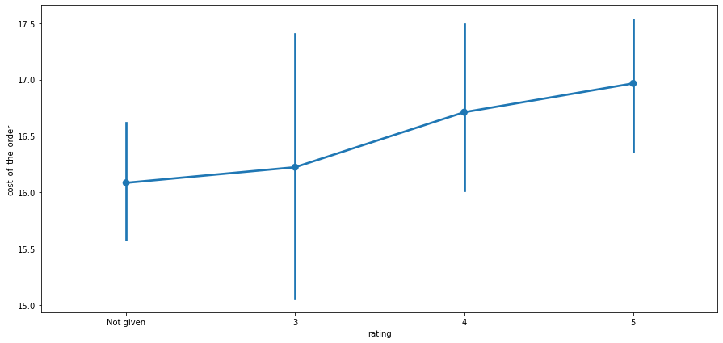
Rating vs Delivery Time
Rating vs
Food Preparation Time
Rating vs
Cost of the Order
Rating 3 does have a higher estimated central tendency and confidence interval for delivery time, but a difference of about 1 min does not seem to warrant a concern.
Across the various ratings, the estimated central tendencies are similar, though rating 3 does have a wider confidence interval.
The higher the rating, the higher is the lower confidence interval and the estimated central tendencies for the cost of the order. They are positively correlated.

Slide 18
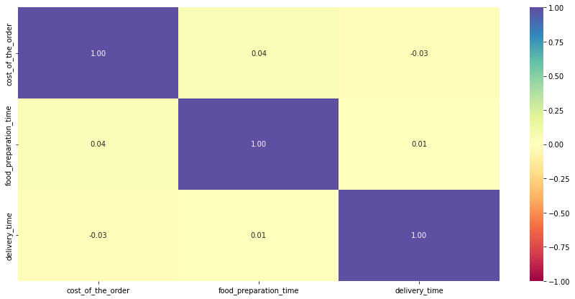
Correlation among Variables
Cost of the Order and Delivery Time are positively correlated with Food Preparation Time.
Cost of the Order and Delivery Time are negatively correlated.
There does not seem to be strong relationship among the 3 variables.

Slide 19
Restaurants Fulfilling Criteria to Get Promotional Offer in Advertisement
Revenue Generated by Restaurants
The revenue generated by the restaurants ranges from 506.47 to 3579.53 dollars.
The top 5 restaurants based on revenue generated coincided with the top 5 restaurants based on orders received.
Shake Shack is leading well ahead. It’s revenue generated is more than 2/3 of the restaurant in 2nd position.
The condition to get the offer is that restaurants must have rating count >50 and average rating >4.
The restaurants fulfilling the criteria to get the promotional offer are Shake Shack, The Meatball Shop, Blue Ribbon Sushi and Blue Ribbon Fried Chicken, as seen in the first 4 rows of the above table.
Net Revenue Generated by the Company Across All Orders
The company charges restaurant 25% on orders having cost greater than 20 dollars and 15% on the orders having cost greater than 5 dollars.
The net revenue is around 6166.3 dollars.

Slide 20
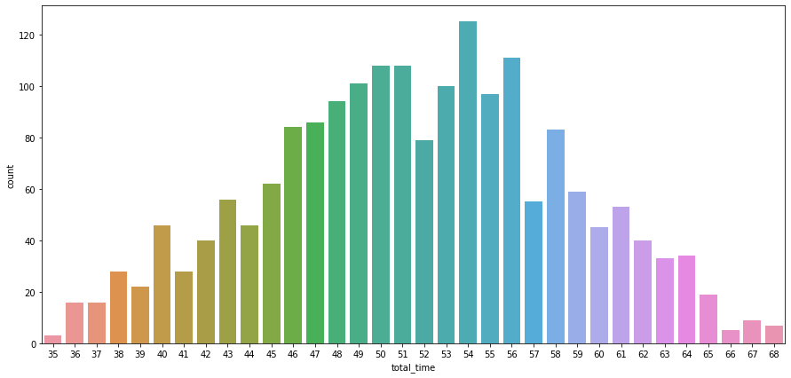
Percentage of Orders that Take More Than 60 Minutes to Get Delivered from Time Order is Placed.
The percentage is 10.54%.
To facilitate further analysis of total time required to deliver food, countplot is used. It is relatively normally distributed, ranges from 35 – 68 mins.

